Slide 1
Lesson objective
PBiS focus
Respect – listening
Empathy – allow others to work
Title: Forming Expressions
Aim – be able to:
Translate mathematical phrases into algebraic terms
Plan:
Review solving equations
Forming equations
Need whiteboards and calculators

Slide 2

Re-teach
2x + 5 = 17
$\frac{x}{5}+2=6$
7c – 18 = 31

Slide 3

Whiteboards
3d + 9 = 27
5t – 4 = 11
9 + 3e = 18
$\frac{x}{3}+5=9$
12 – 3x = 0

Slide 4
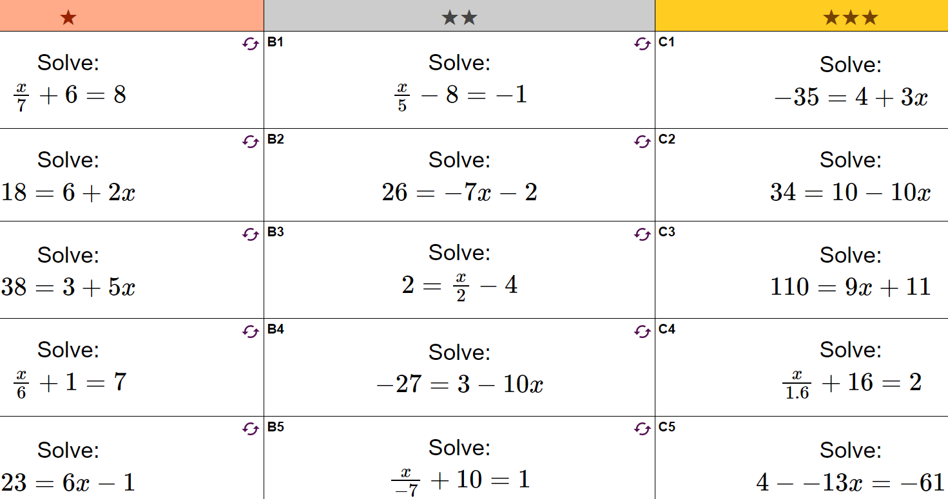

Slide 5
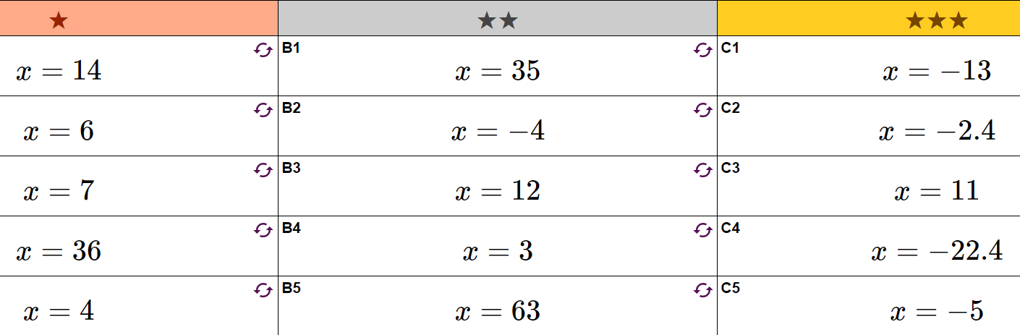

Slide 6
Forming expressions
‘Four more than a number’
‘Four lots of a number’
‘A number divided by 5’
5 more than 2 times a number.
2 increased by 3 times a number.

Slide 7
We do – phrases to algebra
10 minus 4 times a number
5 times a number, plus 9
8 divided by a number, plus 4
3 times the sum of a number plus 4

Slide 8
Whiteboards
10 less than a number
A third of a number
Triple a number and subtract 8
6 increased by 3 times a number
8 times the sum of 5 and a number
3 times the sum of 2 times a number, plus 6

Slide 9
Individual practice
“why doesn’t an elephant smoke?”

Slide 10
Reflection – fist to five
Aim – be able to:
Translate mathematical phrases into algebraic terms

